Slide 1
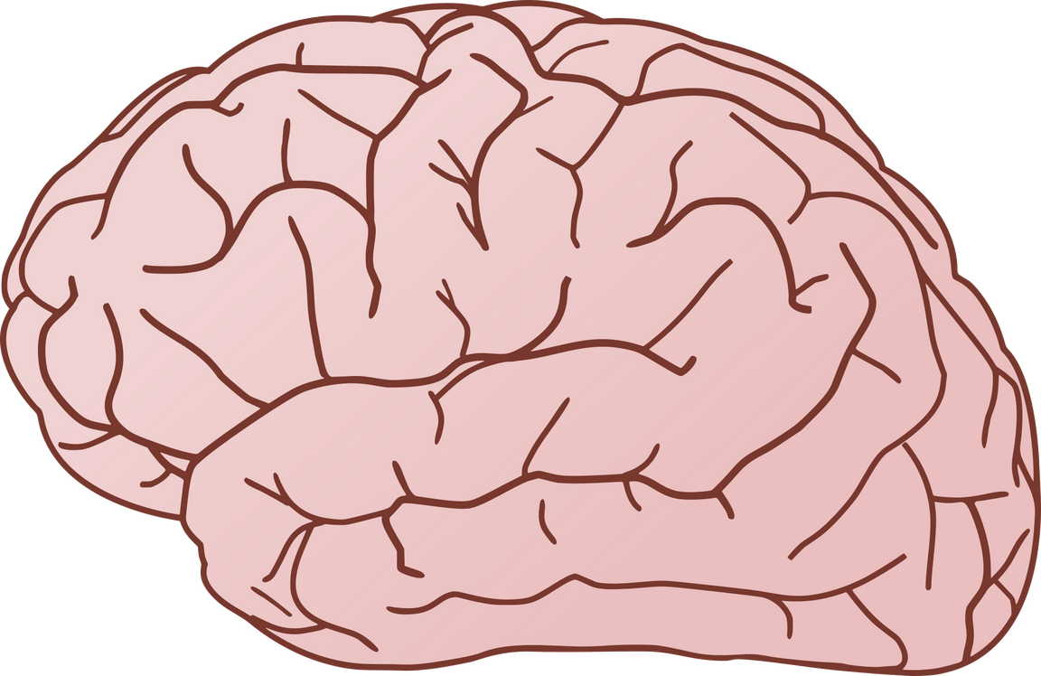
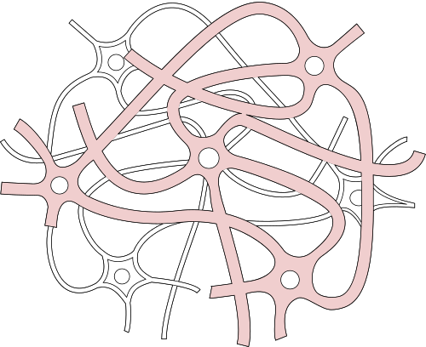
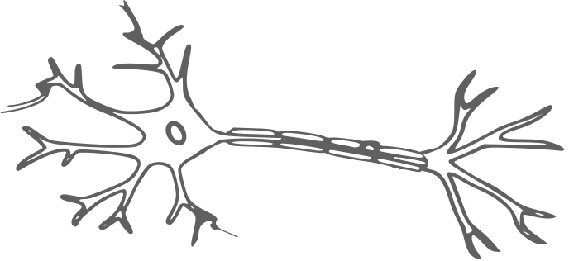
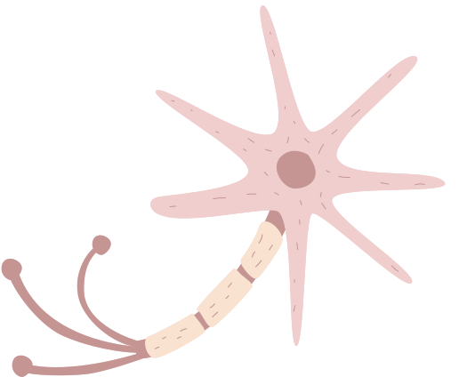
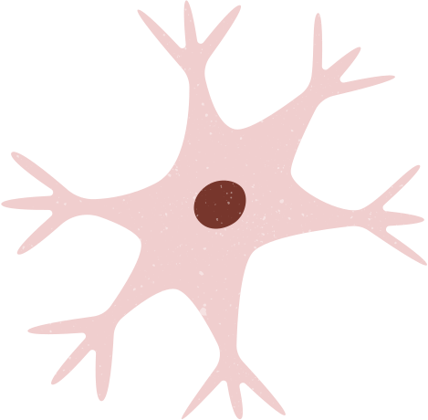
CORTEXA AI
Cognitive Observation & Risk Tracking Engine for Exploratory Analysis using AI

Slide 2
Problem Statement
  Neurological disorders are often detected at later stages.
  Lifestyle and behavioral data are rarely used for early risk prediction.
  Existing systems lack personalized, AI-driven neurological risk assessment.

Slide 3

Methodology
User Input
(Mood, Sleep, Diet, Activity)
Data Processing
(Preprocessing & Scoring)
Feature Extraction
(Behavioral Scores)
START
Insights
(Personalized Recommendations)
Risk Assessment
(Low / High)
AI Risk Prediction
(Binary Classification)
END

Slide 4
System Design
  High-Level Architecture: Client-Server Model.
  Frontend: HTML5, CSS3, and Jinja2 templates for a responsive user dashboard.
  Backend: Flask (Python) handling the request-response cycle and model inference.
  Design Diagrams:
  ER Diagram: Models the logical entities: User, Input Metrics, and Prediction results.
  Data Flow Diagram (Level 1): Illustrates the movement from raw user input to the processed AI prediction.
  Input Requirements: Validates four key parameters: Mood Score (1-10), Sleep Hours (0-15), Activity Rating (1-10), and Diet Quality.

Slide 5
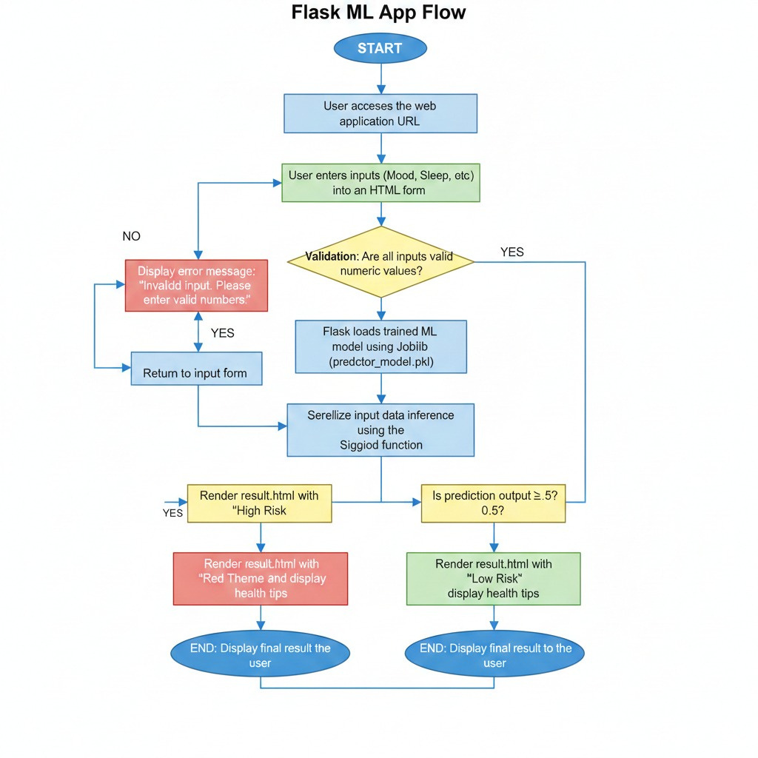
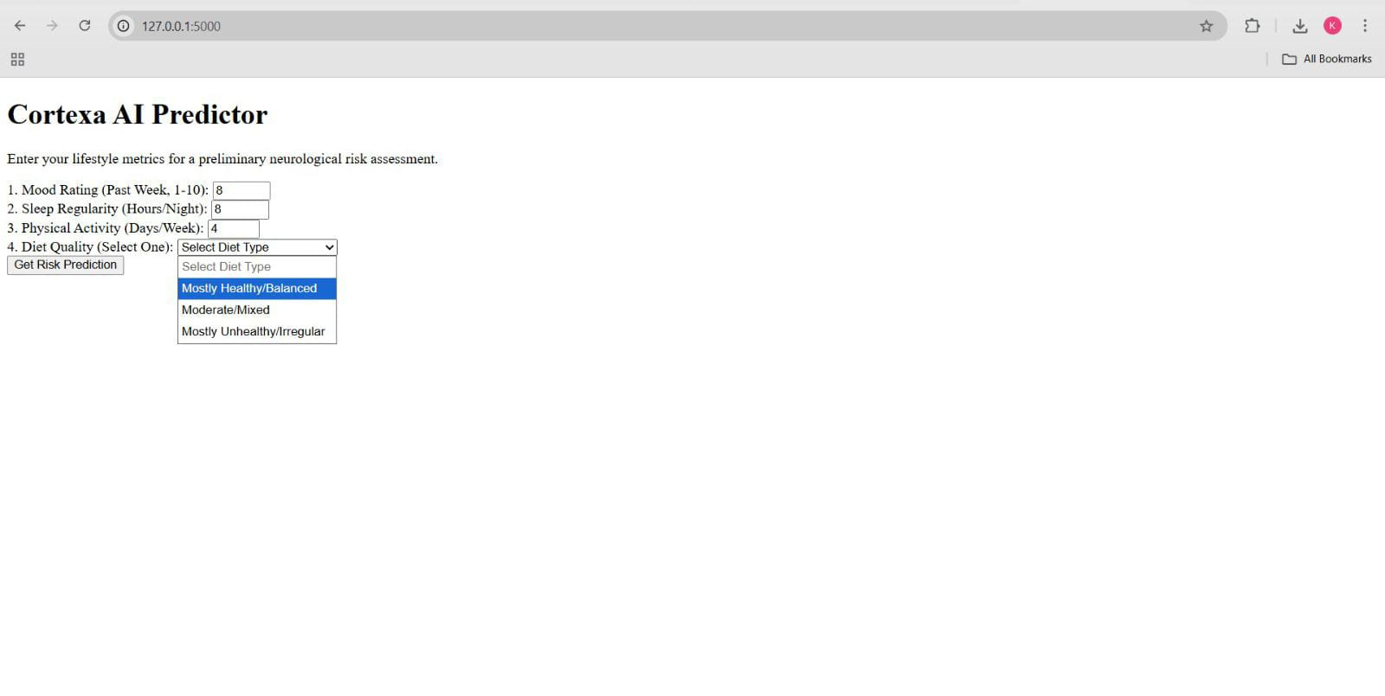
Prototype
Implementation
serialize
sigmoid

Slide 6
Result & Analysis
  System Reliability: The model correctly identifies standard risk profiles based on established lifestyle markers.
  Functional Verification:
  Test Case 1 (High Risk): Input of low sleep (<4 hrs) and low mood (<3) successfully triggers the "High Risk" alert.
  Test Case 2 (Low Risk): Input of optimal sleep (>7 hrs) and high activity triggers the "Neurological Wellness" confirmation.
  Response Latency: System completes the logic execution in under 0.5 seconds locally.

Slide 7
Conclusion & Future Scope
Conclusion:
  Successfully integrated a machine learning model into a user-facing web dashboard.
  Created a working prototype for non-clinical neurological risk screening.
  Maintained a lightweight and high-performance local execution environment.
Future Scope (Roadmap):
Advanced AI: Integration of Recurrent Neural Networks (RNNs) to analyze temporal patterns (trends over weeks).
  Interoperability: Implementation of FHIR/HL7 standards to allow data sharing with hospital management systems.
  IoT Integration: Real-time data sync with smartwatches for automatic sleep and activity logging.

